Slide 1

BARKATULLAH UNIVERSITY INSTITUTION OF TECHNOLOGY
TOPIC :- “InvestSafe - A STOCK PRICE PREDICTION WEBAPP”
BRANCH:- COMPUTER SCIENCE(8TH SEMESTER)
SUBMITTED BY:-
RITU BACHLE(R218237200022)
RUSHALI KATHODE(R228237200073)
OJASWI SHARMA(R218237200030)

Slide 2
InvestSafe -STOCK PRICE PREDICTION WEBAPP

Slide 3
CONTENT
Machine Learning (Linear regression)
Deep Learning (LSTM)
Deep Learning Necessity
Google Stock Price Dataset
Streamlit
Pandas
cufflinks
8. Conclusion

Slide 4
ABSTRACT
This project “InvestSafe- A STOCK PRICE PREDICTION WEB APP ” is a web app that forecast the prices and Bollinger Band graph of Stocks. Also it shows how can we use Machine Learning Techniques to Predict the Stock Values. Streamlit, a well-known Python framework for creating data-driven web applications, is used to forecast stock values and machine learning algorithms like Linear Regression (LR) and Long Short-Term Memory (LSTM) is used to predict Stock Prices. While LSTM is a more complicated method that may capture the long-term dependencies in time series data, LR is a straightforward and quick algorithm that fits a linear model to the data .

Slide 5
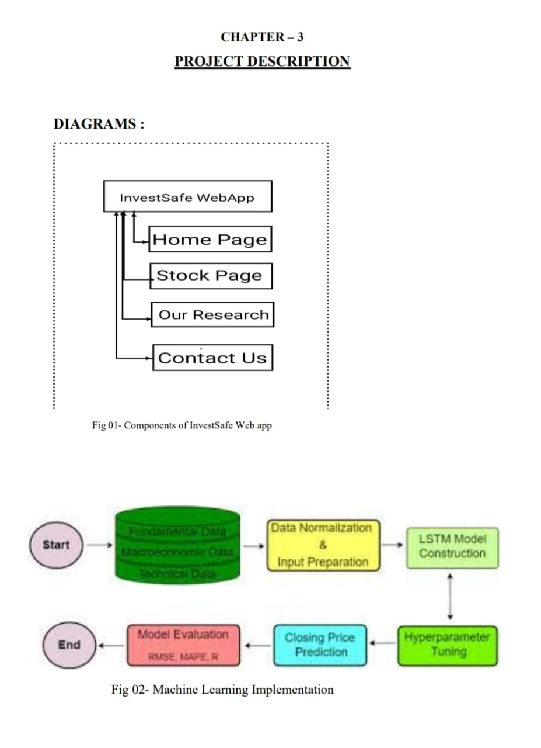
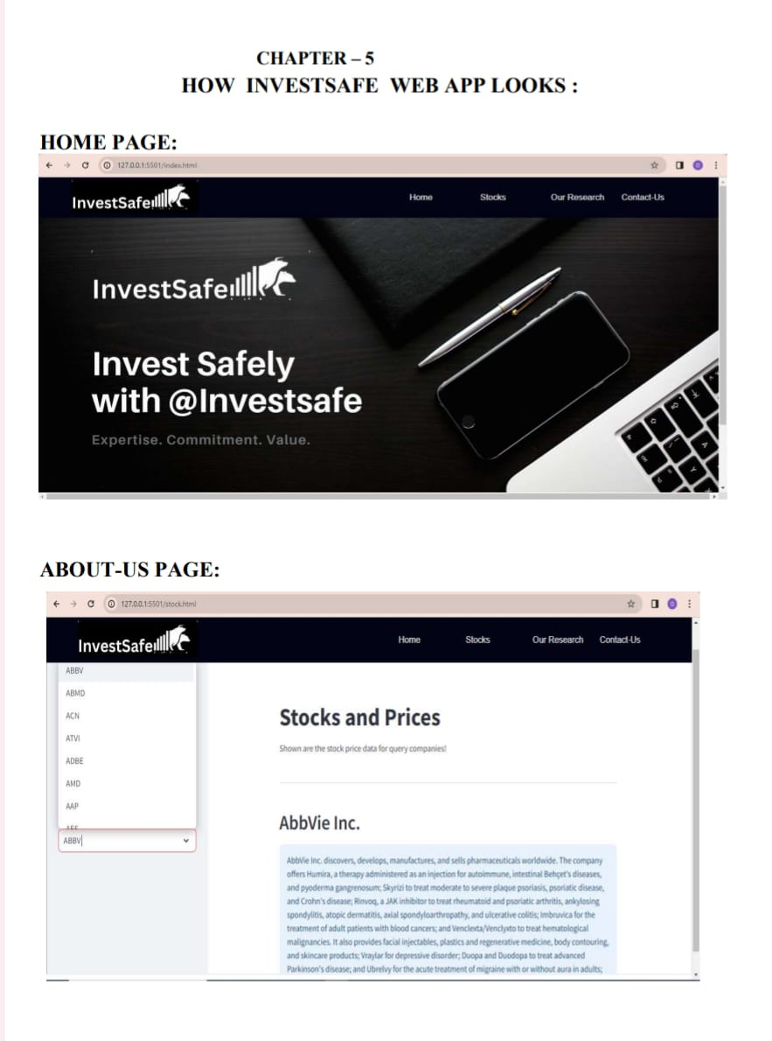

Slide 6
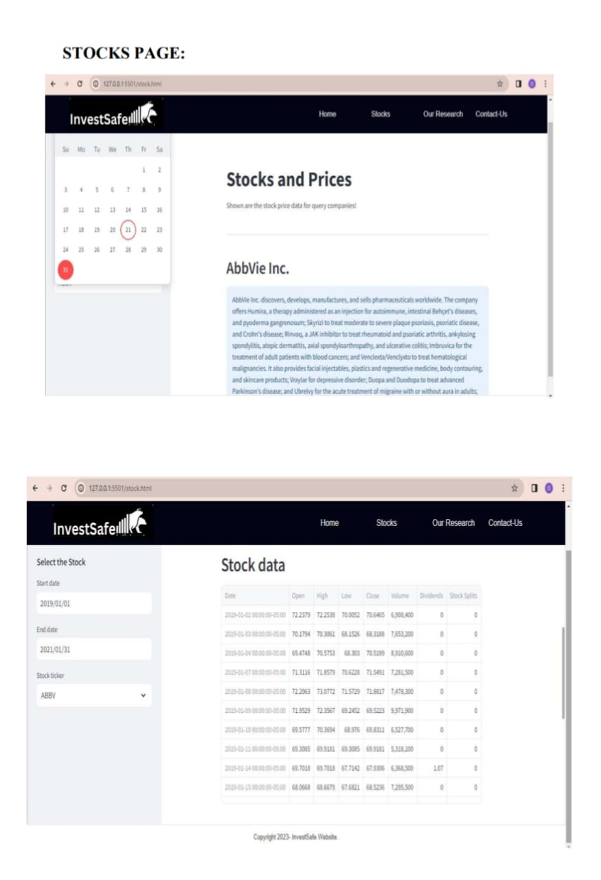
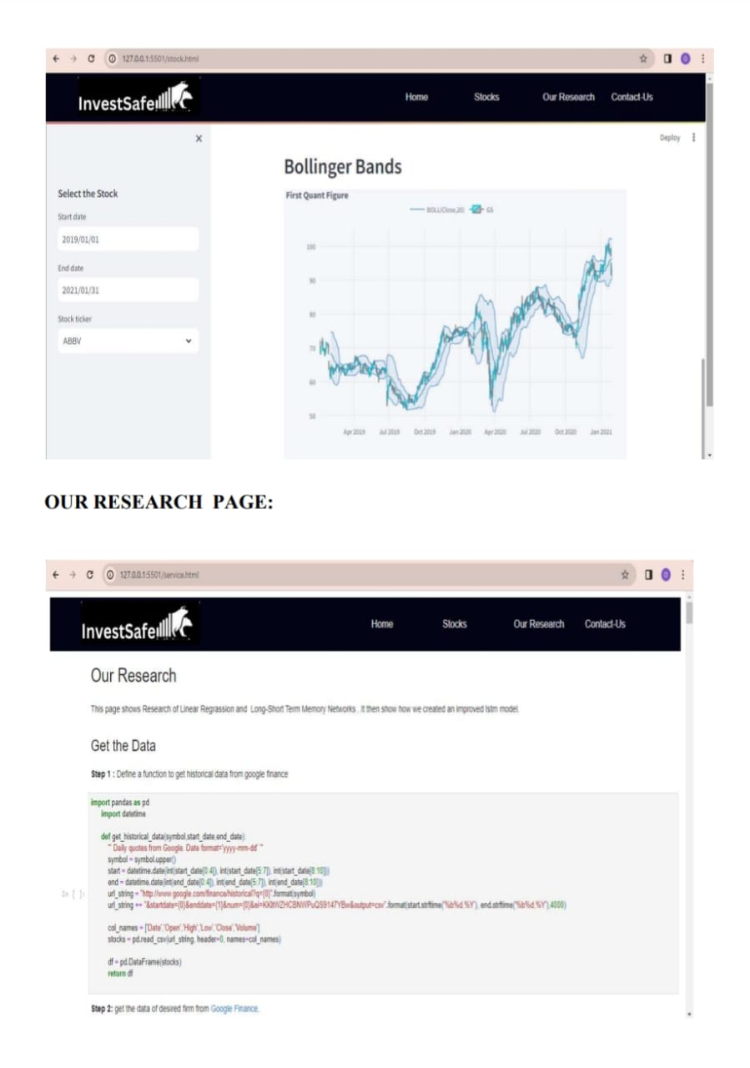

Slide 7
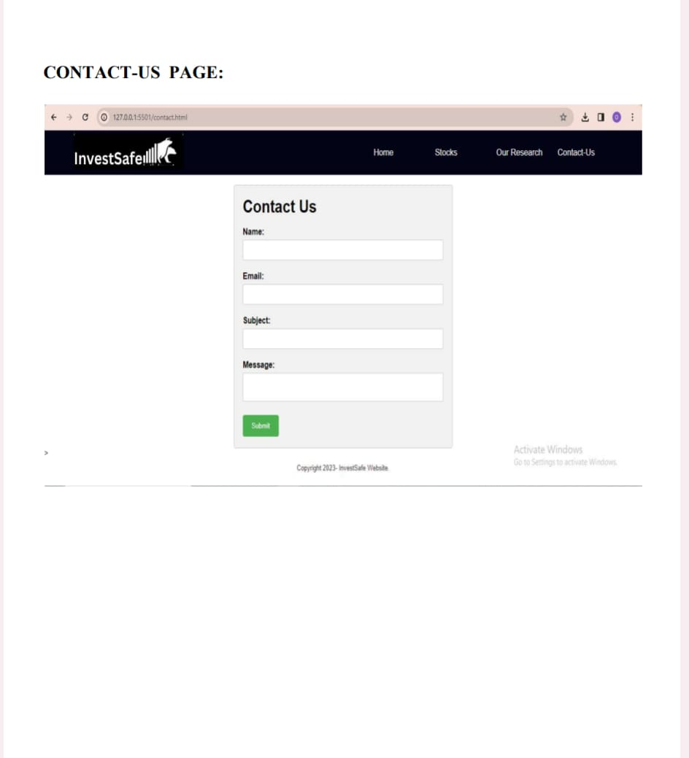

Slide 8
MACHINE LEARNING
Machine learning is the science of getting computers to act without being explicitly programmed.
Machine learning is important because it gives enterprises a view of trends in customer behaviour and business operational patterns, as well as supports the development of new products.
Linear regression
Linear regression is the analysis of two separate variables to define a single relationship and is a useful measure for technical and quantitative analysis in financial markets. Plotting stock prices along a normal distribution—bell curve—can allow traders to see when a stock is overbought or oversold.

Slide 9
DEEP LEARNING
Deep learning is an artificial intelligence (AI) function that imitates the workings of the human brain in processing data and creating patterns for use in decision making.
Deep learning attempts to mimic the human brain—albeit far from matching its ability—enabling systems to cluster data and make predictions with incredible accuracy.
LSTM(Long Short Term Memory)
LSTM stands for long short-term memory networks, used in the field of Deep Learning. It is a variety of recurrent neural networks (RNNs) that are capable of learning long-term dependencies, especially in sequence prediction problems.

Slide 10
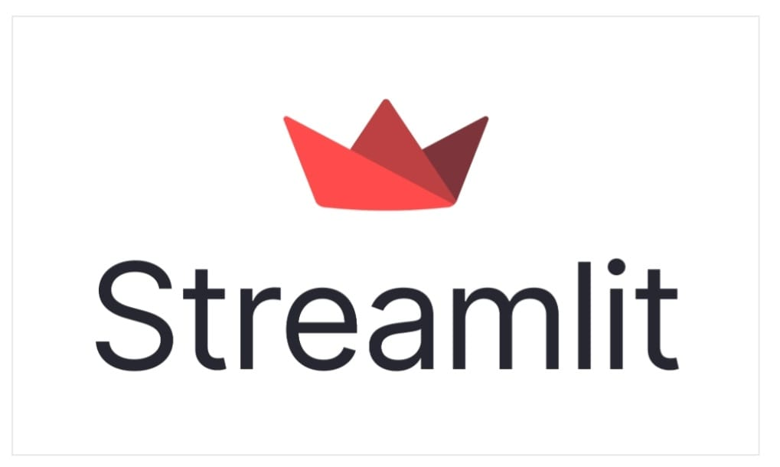
LIBRARIES USED :
PANDAS : Pandas is a software library for data management and analysis created in the Python programming language. It provides data structure and functionality specifically for working with phone numbers and business hours. It is free software released under the three-part BSD license.
STREAMLIT : A promising open source Python module called Streamlit enables programmers to design user interfaces that flow naturally. Streamlit is the easiest way to put their code in a web application, especially for people with no prior knowledge: No recent (html, js, css) knowledge or knowledge.
YFINANCE : One of them in Python is yfinance. dependable details Online information from which we can gather Yahoo financial information. The yfinance module enables us to gather and store financial data (financial ratios, etc.) about businesses. on the document's top.

Slide 11
CUFFLINK : Cufflink is also a python library that connects plotly with pandas so that we can create charts directly on data frames. It basically acts as a plugin.
DATETIME : One of the most popular modules for manipulating date and time object data is Python's internal date/time library. You can create date and date objects, iterate through a date range, parse and write date strings, and more.
NUMPY : Nearly all branches of research and engineering use the free source Python library known as NumPy (Numerical Python). It is a consistent standard for working with mathematical data in Python and is the foundation of Python research and PyData ecosystems.

Slide 12
KERAS : Deep models made with Keras can be built on mobile devices. Keras is also used in distributed deep learning model training. Used by Keras, Netflix, Yelp, Uber and more.
SCIKIT-LEARN : An open source data analytics library called Scikit-learn is the industry benchmark for machine learning (ML) in the Python community. Key concepts and capabilities include: algorithmic decision making, including: Classification: identifying and classifying data based on patterns.
TENSORFLOW : TensorFlow is an artificial intelligence and machine learning software library that is free and open source. It can be used for many tasks, but focuses specifically on the training and theory of deep neural networks.

Slide 13
DEEP LEARNING NECESSITY
Deep learning has evolved hand-in-hand with the digital era, which has brought about an explosion of data in all forms and from every region of the world. This data, known simply as big data, is drawn from sources like social media, internet search engines, e-commerce platforms, and online cinemas, among others. This enormous amount of data is readily accessible and can be shared through fintech applications like cloud computing.
However, the data, which normally is unstructured, is so vast that it could take decades for humans to comprehend it and extract relevant information. Companies realize the incredible potential that can result from unraveling this wealth of information and are increasingly adapting to AI systems for automated support.

Slide 14
GOOGLE STOCK DATASET
Google LLC is an American multinational technology company that specializes in Internet-related services and products, which include online advertising technologies, a search engine, cloud computing, software, and hardware.
It is considered one of the big four Internet stocks along with Amazon, Facebook, and Apple
The company is listed on the NASDAQ stock exchange under the ticker symbol GOOG.
We have Included 5 year Stock Price of Google for this Project.

Slide 15
CONCLUSION
Predicting the accuracy of the closing price of a certain product at a certain time in the future is the main problem of this study. In the last few years, many academic papers have been published using neural networks to predict the prices of products with different levels of success, but until recently, only this training could create these patterns. With the help of a framework like TensorFlow, anyone can now build predictive models that have learned a lot of data. To predict the closing price of the S&P 500 using historical price data, I will use the Short Term Memory network, often referred to as the "LSTM" in this study.

Slide 16
THANK YOU

